Slide 1
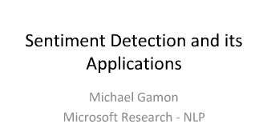

Slide 2
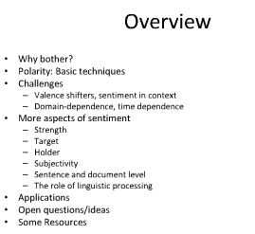

Slide 3
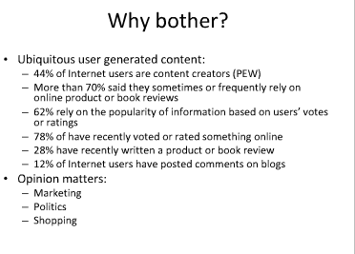

Slide 4
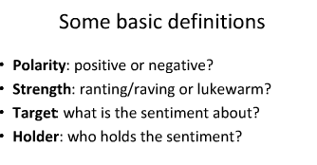

Slide 5
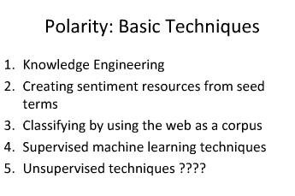

Slide 6
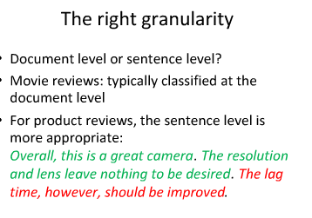

Slide 7
Corpus vs Dataset
"corpus" mainly appears in NLP area or application domain related to texts/documents, because of its meaning "a collection of written texts, esp. the entire works of a particular author or a body of writing on a particular subject." (https://www.google.com/search?q=define+corpus)
"Corpus is a large collection of texts. It is a body of written or spoken material upon which a linguistic analysis is based
In contrast, dataset appears in every application domain --- a collection of any kind of data is a dataset.

Slide 8
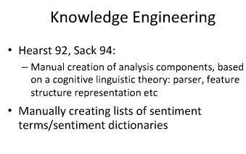

Slide 9
Different Methods
Corpus
We need a collection of movie reviews that include both positive reviews and negative reviews.
Good corpus resources should have good review quality, available metadata, easy spidering, and reasonably large number of reviews and products
The ratings were removed. The rating decision was made in order to transform a 4-star or 5-star rating-system reviews into positive and negative reviews
N-Gram Classifiers
we selected n-gram models as supervised approach, which represent text documents by word tuples.
The tool is implemented with classification algorithms based on n-gram (unigram, bigrams, and tri-grams) features.
Wherever Times is specified, Times Roman or Times New Roman may be used. If neither is available on your word processor, please use the font closest in appearance to Times

Slide 10
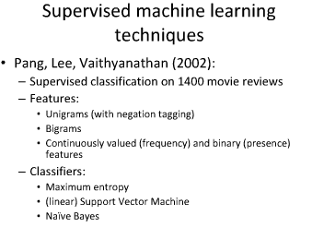

Slide 11
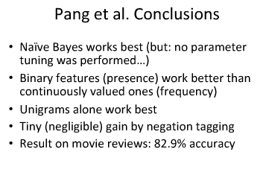

Slide 12
Naive Bayes classifier
In machine learning, naive Bayes classifiers are a family of simple probabilistic classifiers based on applying Bayes' theorem with strong (naive) independence assumptions between the features.
Naive Bayes has been studied extensively since the 1950s. It was introduced under a different name into the text retrieval community in the early 1960s,^{[1]:488} and remains a popular (baseline) method for text categorization, the problem of judging documents as belonging to one category or the other (such as spam or legitimate, sports or politics, etc.) with word frequencies as the features. With appropriate preprocessing, it is competitive in this domain with more advanced methods including support vector machines.^{[2]} It also finds application in automatic medical diagnosis

Slide 13

Bayes' theorem is stated mathematically as the following equation:^{[2]}
where A and B are events.
P(A) and P(B) are the probabilities of A and B without regard to each other.
P(A | B), a conditional probability, is the probability of observing event A given that B is true.
P(B | A) is the probability of observing event B given that A is true.

Slide 14

Constructing a classifier from the probability model[edit]
The discussion so far has derived the independent feature model, that is, the naive Bayes probability model. The naive Bayes classifier combines this model with a decision rule. One common rule is to pick the hypothesis that is most probable; this is known as the maximum a posteriori or MAP decision rule. The corresponding classifier, a Bayes classifier, is the function that assigns a class label
for some k as follows:

Slide 15
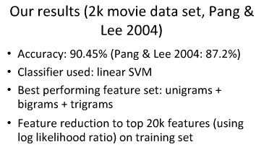

Slide 16
N-Gram
n-gram. ... The n-grams typically are collected from a text or speech corpus. When the items are words,
n-grams may also be called shingles.
An n-gram of size 1 is referred to as a "unigram";
size 2 is a "bigram" (or, less commonly, a "digram");
size 3 is a "trigram

Slide 17
Example of n-gram
Field | Unit | Sample sequence | 1-gram sequence | 2-gram sequence | 3-gram sequence
Vernacular name |  |  | unigram | bigram | trigram
Order of resulting Markov model |  |  | 0 | 1 | 2
Protein sequencing | amino acid | … Cys-Gly-Leu-Ser-Trp … | …, Cys, Gly, Leu, Ser, Trp, … | …, Cys-Gly, Gly-Leu, Leu-Ser, Ser-Trp, … | …, Cys-Gly-Leu, Gly-Leu-Ser, Leu-Ser-Trp, …
DNA sequencing | base pair | …AGCTTCGA… | …, A, G, C, T, T, C, G, A, … | …, AG, GC, CT, TT, TC, CG, GA, … | …, AGC, GCT, CTT, TTC, TCG, CGA, …
Computational linguistics | character | …to_be_or_not_to_be… | …, t, o, _, b, e, _, o, r, _, n, o, t, _, t, o, _, b, e, … | …, to, o_, _b, be, e_, _o, or, r_, _n, no, ot, t_, _t, to, o_, _b, be, … | …, to_, o_b, _be, be_, e_o, _or, or_, r_n, _no, not, ot_, t_t, _to, to_, o_b, _be, …
Computational linguistics | word | … to be or not to be … | …, to, be, or, not, to, be, … | …, to be, be or, or not, not to, to be, … | …, to be or, be or not, or not to, not to be, …

Slide 18
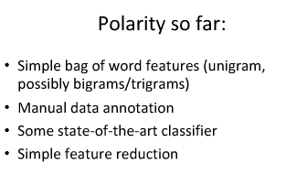

Slide 19
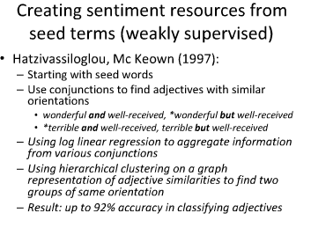

Slide 20
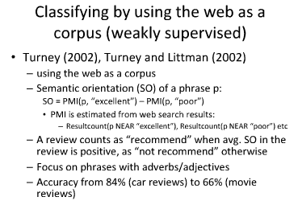

Slide 21
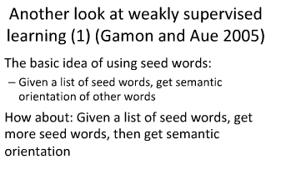

Slide 22
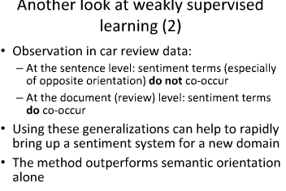

Slide 23
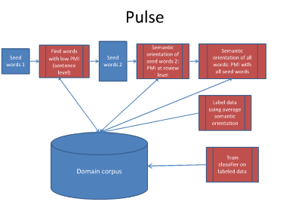

Slide 24
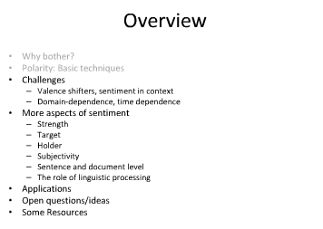

Slide 25
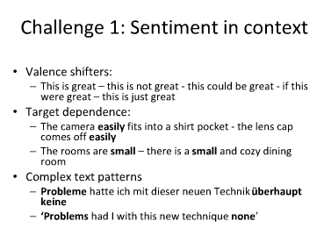

Slide 27
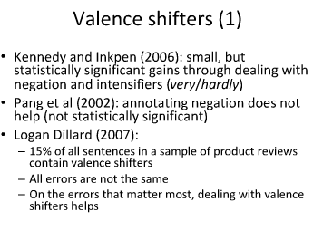

Slide 28
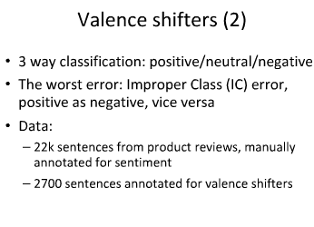

Slide 29
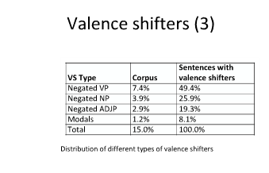

Slide 30
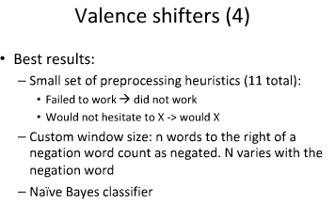

Slide 31
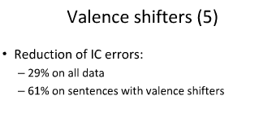

Slide 32
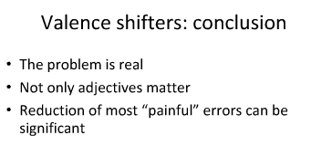

Slide 33
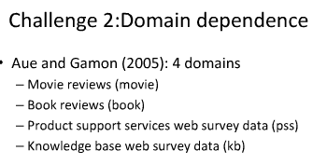

Slide 34
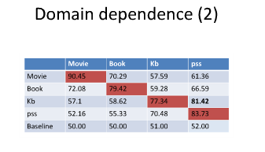

Slide 35
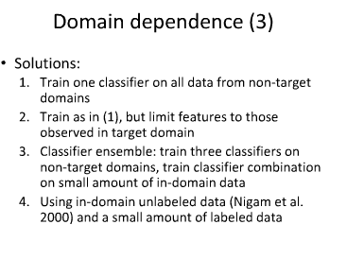

Slide 36
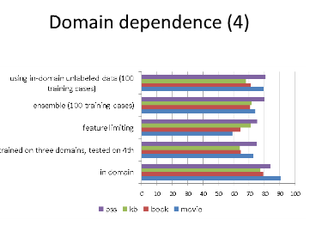

Slide 37
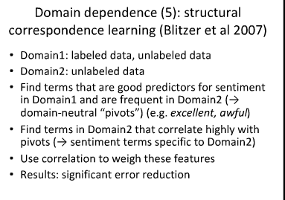

Slide 38
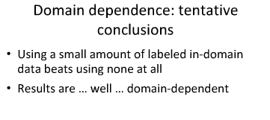

Slide 39
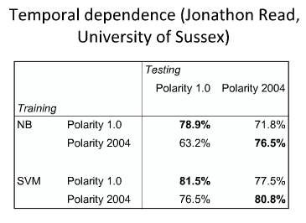

Slide 40
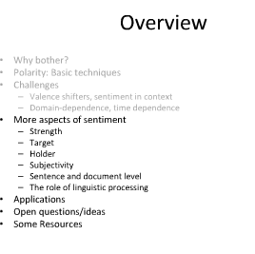

Slide 41
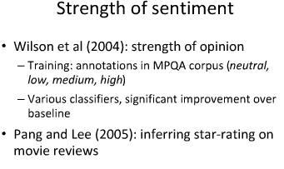

Slide 42
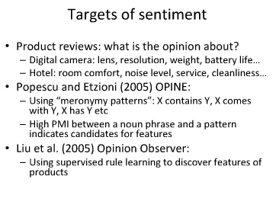

Slide 43
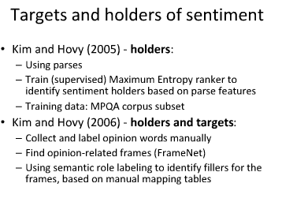

Slide 44
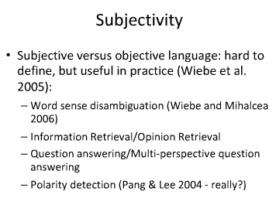

Slide 45
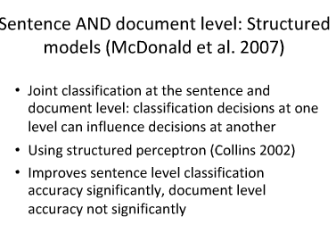

Slide 46
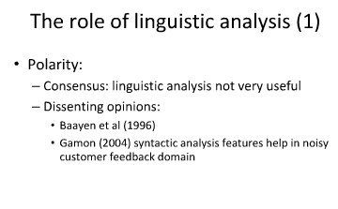

Slide 47
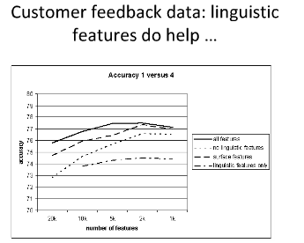

Slide 48
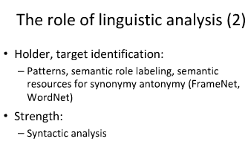

Slide 49
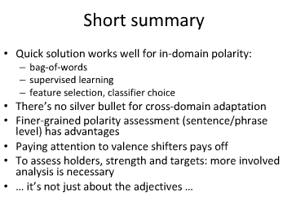

Slide 50
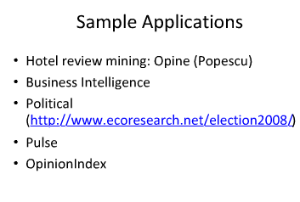

Slide 51
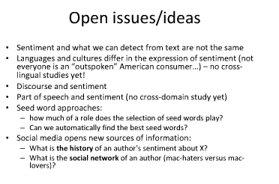

Slide 52
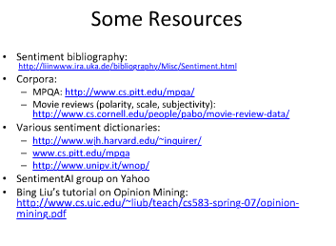

Slide 53
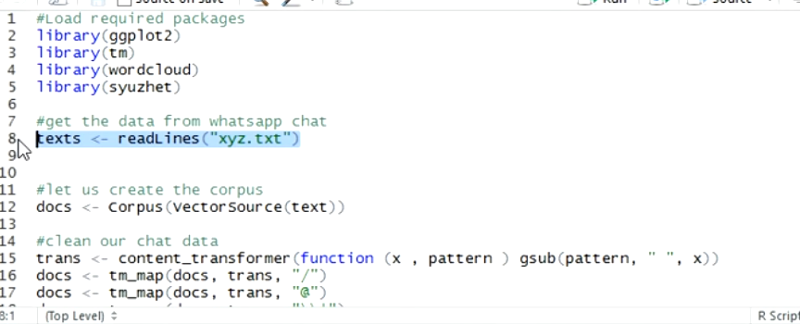
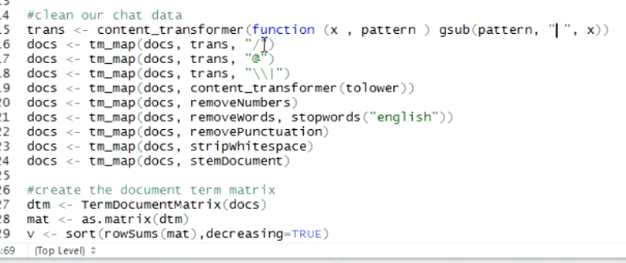

Slide 54
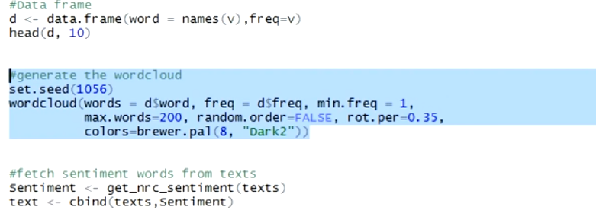

Slide 55
Data
Probably this book deserves two or three stars, as an engaging (chatty) survey of the profound changes in technology we have been and are experiencing. I give it one star, however, as my protest against the rave reviews from so many uncritical readers. In a sense, Friedman's approach is inductive: present lots and lots of cases - and cite countless high-flying technies and "big thinkers" - stir in heavy doses of optimism (or is it fatalism camouflaged as optimism?), and call it a book. Quite simply, anecdotes plas optimism do not yield a solid analysis of the broader society.
Friedman has a perfect right to be optimistic. But as a critical reader (and social scientist) I reserve my right to say that he does not make the case for where we are heading and that it will be glorious. Nor are techies abd their fans the best judges of what they are doing to the broader society.
Friedman offers a compelling, well-researched paradigm for understanding how the US arrived at its current level of dysfunctional politics. His hypothesis, restated throughout the book is that the US, as well as the rest of the planet, is being subjected to three relentless, ineluctable forces: the exponential development of technology, the forces of globalization and concomitant interdependence, and severe climate change, all of which have altered forever the complacent stability to which we had become accustomed. He argues further that the pace of change (speed) as well as the rate of change (exponential) are exceeding in many cases, the capacity of individuals and societies to adapt to change, while politicians--glued to their own narrow ideologies and even narrower political bases--provide only simplistic, quixotic and ultimately futile responses.
Though I could have done without the plethora of folksy interjections, as a whole the argument made is compelling, well documented and (for me) fairly frightening. In the closing chapters of the book, Friedman offers several common sense, pragmatic solutions and manages to convey a sense of optimism that eventually, the world will be capable of adapting in a manner that improves global civilization. Given the facts and strong arguments made in preceding chapters however, the optimism seems unfounded;; particularly given the lack of political will for the heterodox approach that the author justifiably feels that circumstances require.

